Slide 1
AWS : PRESENTATION
Project : E-Commerce Startup Infrastructure

Slide 2
Business Case
A startup called ShopNow is launching an online store.
They expect increasing traffic and need a secure, scalable, highly available AWS infrastructure.

Slide 3
Services Covered
VPC
EC2
Security Groups
Application Load Balancer
S3
RDS
IAM
Auto Scaling

Slide 4
Networking
•⁠ ⁠Create custom VPC
•⁠ ⁠2 Availability Zones
•⁠ ⁠Public subnet → Load Balancer
•⁠ ⁠Private subnet → Application servers
•⁠ ⁠Private DB subnet → RDS
Compute
•⁠ ⁠Deploy web server on EC2
•⁠ ⁠No public IP on application instances
Storage
•⁠ ⁠Store product images in S3
Database
•⁠ ⁠MySQL RDS instance
•⁠ ⁠Accessible only from application servers
Traffic
•⁠ ⁠Internet → ALB → EC2 → RDS

Slide 5
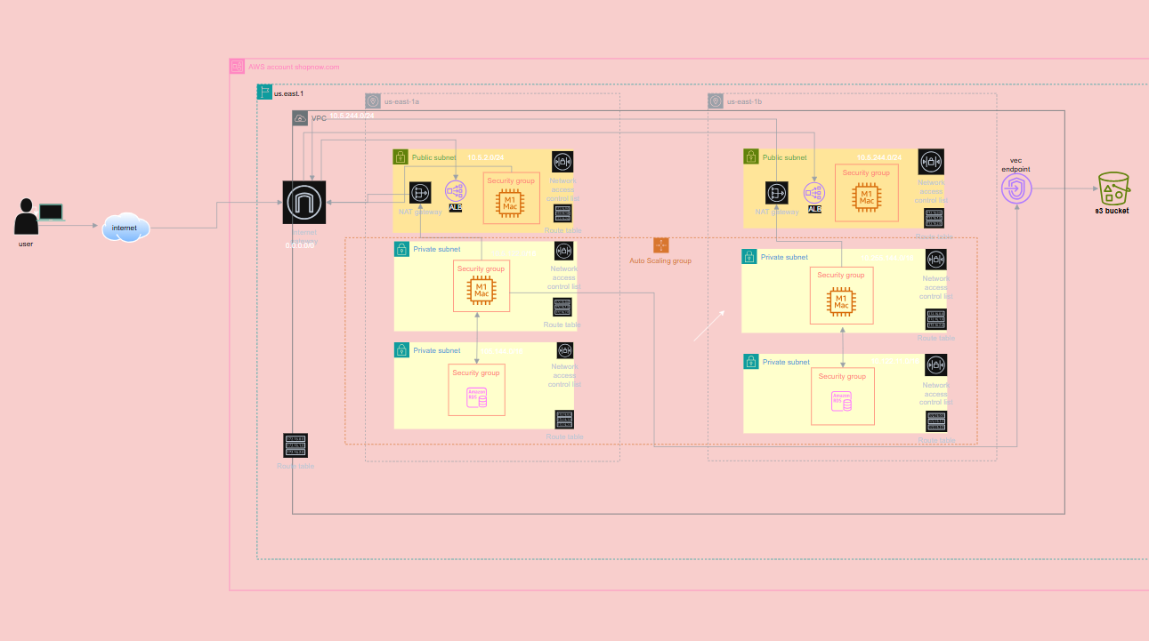
Infrastructure : Architecture Diagram

Slide 6
Components used to build infrastructure
VPC= virtual private network
Availability zone= 2 AZ's
Public subnet= 2 public subnet in two different region
Private subnet= used 4 private subnet (2 private subnet in each region)
ALB= Application load balancer used for publicly exposed the private instances or balanced the load
EC2= for run the user data script
SG= security group instance level firewall
NACL=network access control list subnet level firewall
Internet gateway= inbound and outbound internet connectivity and attached to vpc
NAT gateway=used for outbound internet connectivity to inside private subnet instance
Route Tables=used for define route/path
VPC endpoint= to connect EC2 instance to bucket without using Internet gateway and Nat gateway
S3 bucket
ASG=Auto scaling group used for high availability
RDS= data

Slide 7
EC2 Instance user data script
#!/bin/bash
sudo yum update-y
#Install Apache web server (httpd)
sudo yum install-y httpd
sudo systemctl start httpd
sudo systemctl enable httpd
#Create a simple HTML file to verify the web server is running
echo"<html><h1>Welcome to Apache Web Server on Amazon Linux!</h1></html>">/var/www/html/index.html

Slide 8
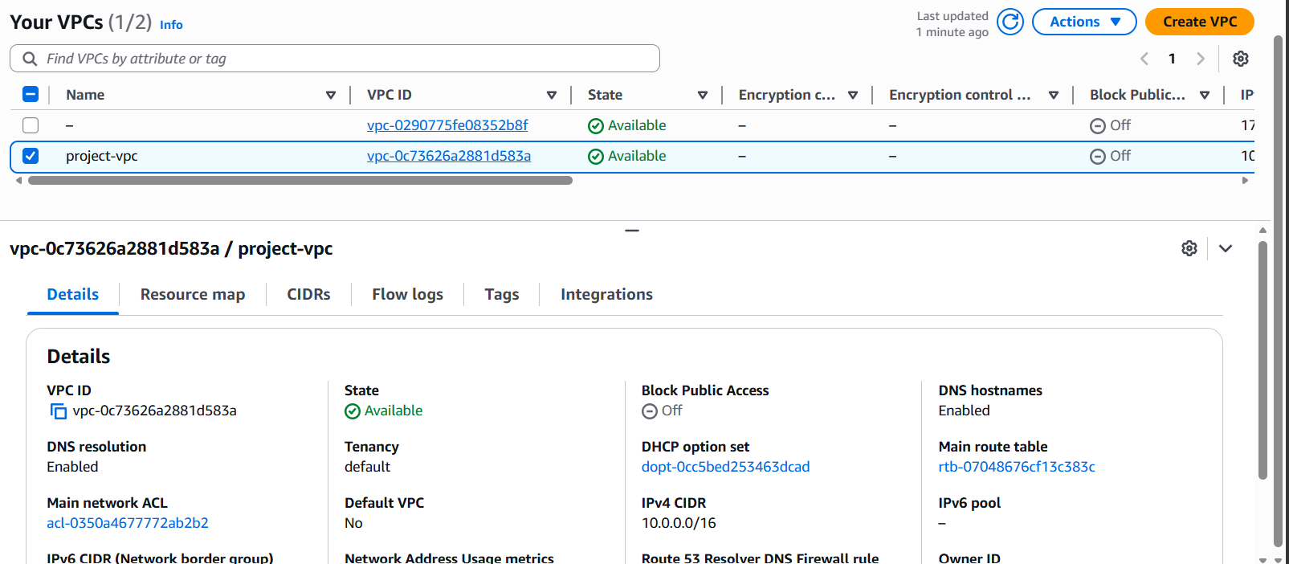
Create vpc

Slide 9
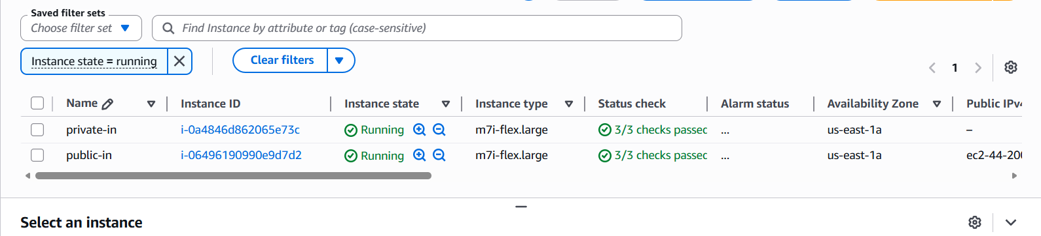
Instance: private and public

Slide 10
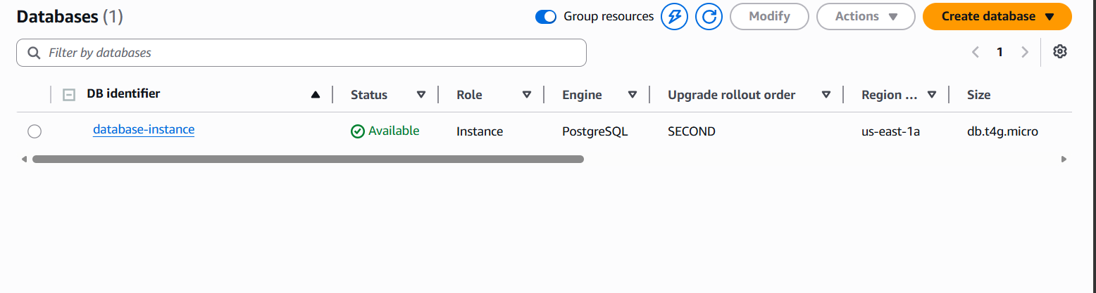
RDS database

Slide 11
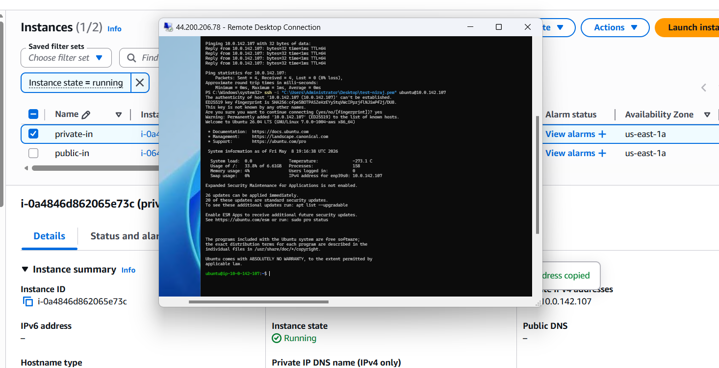
CONNECTIVITY :public to private

Slide 12
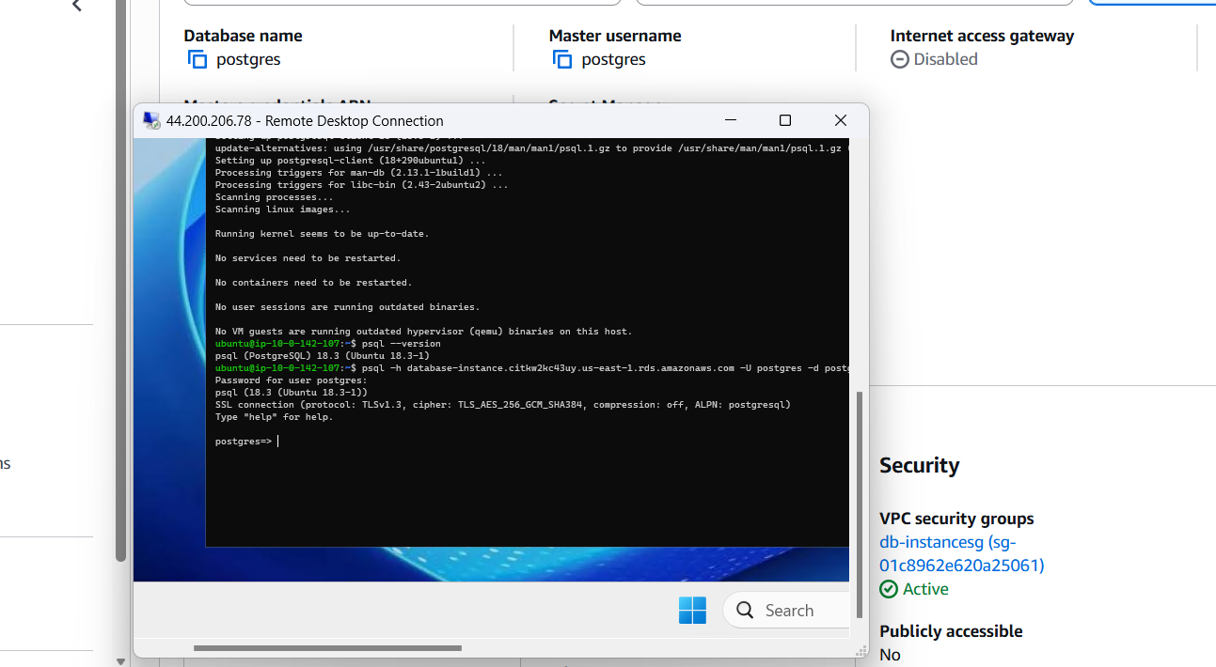
CONNECTIVITY: Private to RDS instance

Slide 13
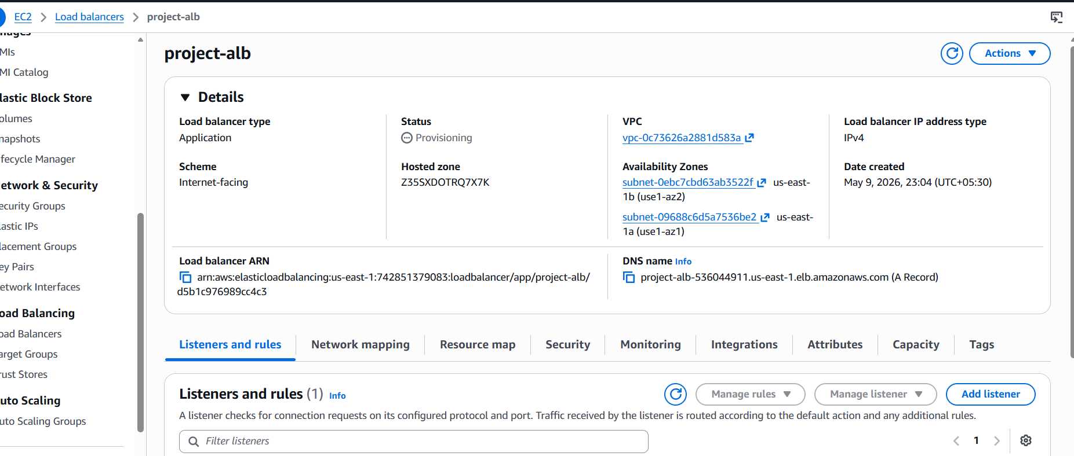
Load balancer : Application load balancer

Slide 14
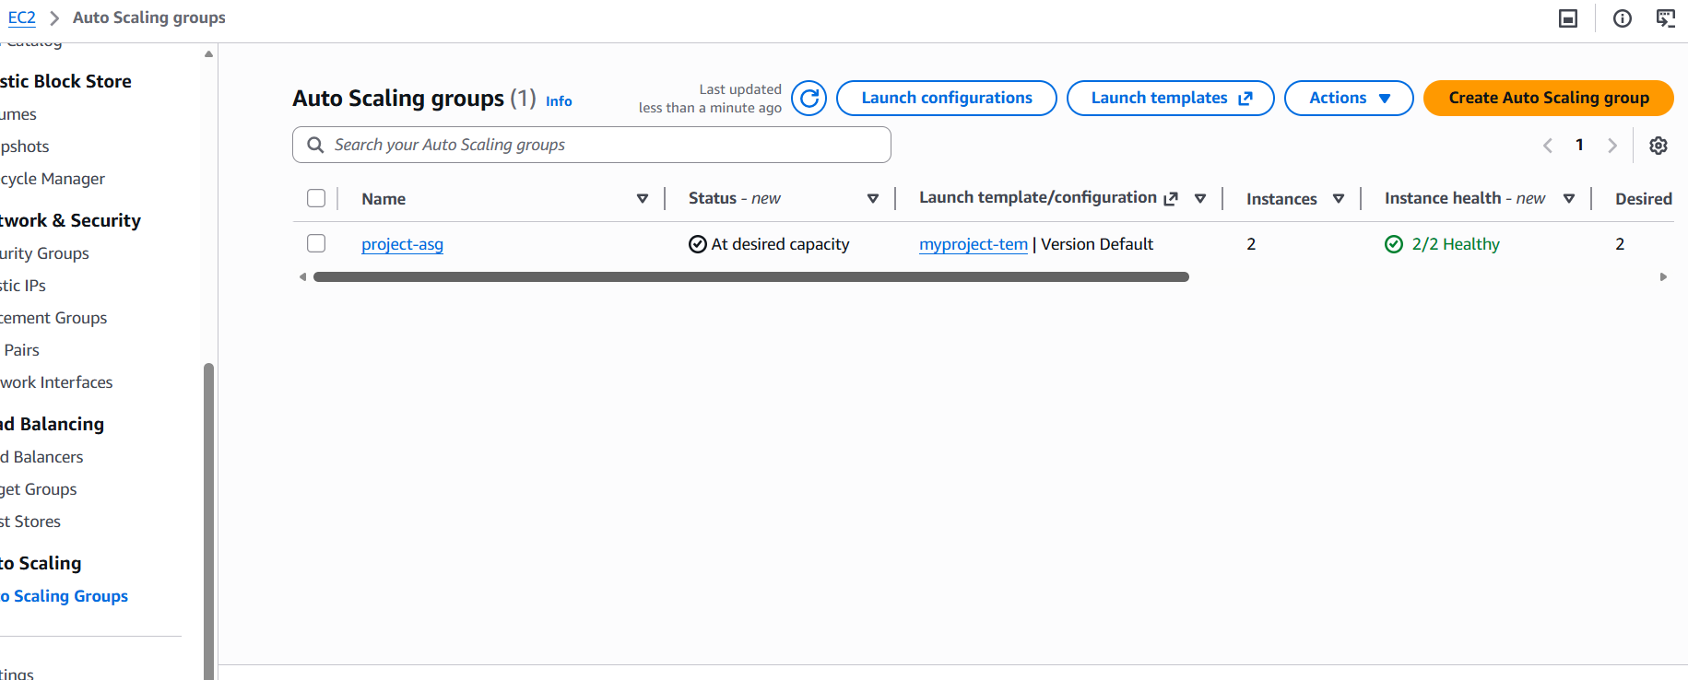
ASG:

Slide 15
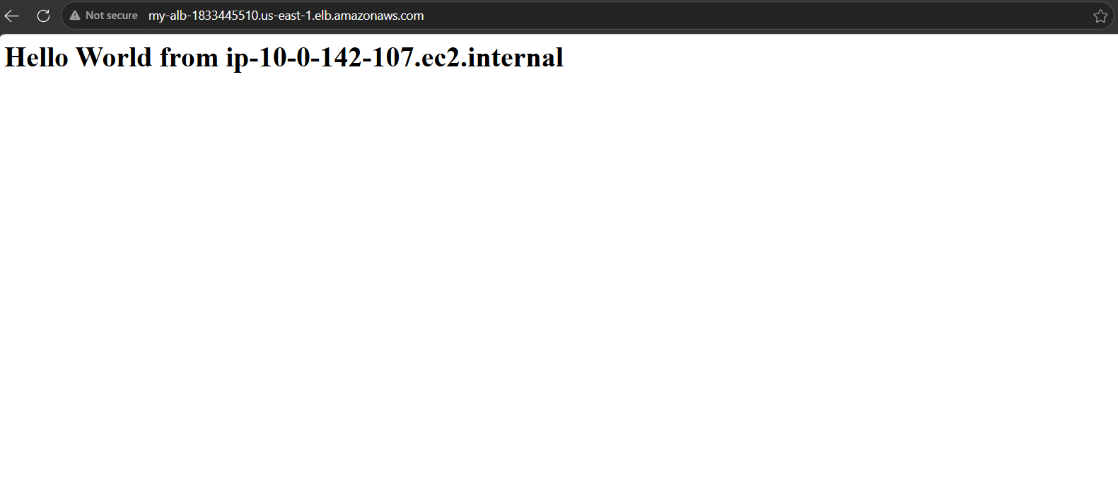
FINAL OUTPUT

